Slide 1

Electrify Program Pitch Deck Template for Engaging with Key Partners
Last Updated 10/10/2024
If you have suggestions or comments, please contact Ryan Shea at rshea@rmi.org
Notes:
Photo credit: https://www.weforum.org/communities/gfc-on-clean-electrification

Slide 2
Pitch Deck Template Guidance
What is the purpose of this pitch deck?
Provide local government staff a customizable resource when engaging with partners for an “Electrify” or heat pump adoption campaign.
What does this pitch deck include?
Easily modifiable slide templates with helpful information needed to structure conversations with key Electrify campaign partners.
How do you use this pitch deck?
Identify the story you are trying to tell and the relevant slides in this deck that can help you convey that message.
Read the instruction callout on each slide, update the slide contents as needed, and then delete the callout.
Update and add any content outside of the instructions to help convey your message.
Review speaker notes on each slide for talking points or additional information.
Put this presentation in your local government’s standard template (if applicable) and delete this slide before presenting.

Slide 3
[Stakeholder Type] Roles in [City/County]’s Electrify Campaign
[Date],[Year]
Instructions:
Remove slides 1 & 2 after reviewing
Utilize the “replace all” function to replace references to “[City/County]” with the name of your community throughout the deck.
Edit the yellow “Stakeholder Type” text to reflect the stakeholder audience.
Edit the text in “[Date], [Year]” to the date of this presentation.
Add your logo to all slides using the Slide Master.
Notes:
Photo credit: https://www.weforum.org/communities/gfc-on-clean-electrification

Slide 4
Agenda
Local Government’s Heat Pump Priority
Local Government’s Heat Pump Priority
Benefits and Challenges of Electrify campaigns
Discussing Potential Partner Roles

Slide 5
[City/County] has prioritized building electrification in our climate action plan
Instructions:
Edit the text in yellow to replace references to “[City/County]” with the name of your community.
Update each box with details of your community’s climate action plan – this could include specific goals or overall emissions targets that building electrification will be required to reach.
[City/County]’s Climate Action Plan has a goal of [100% electric by 2050/no gas in new buildings/emissions reduction target of X% that will be aided by electrification]
XX% of [City/County]’s greenhouse gas emissions come from buildings
[insert community GHG inventory pie chart if available]

Slide 6




Heat pumps are a critical building electrification solution and bring many local benefits
Instructions:
Edit the text in yellow to replace references to “[City/County]” with the name of your community.
Update the text in yellow text by right-clicking on the yellow box at the bottom of the slide and selecting Worksheet Object -> Open. Follow the worksheet instructions
Update the remaining yellow text with a) your community’s local air pollution from buildings data, if available, b) the number of unsafe air days using the EPA’s Air Quality Index report, and c) pollution impacts using RMI’s state impact calculator.
Reduce GHG Emissions | Reduce Air Pollution | Improved Energy Efficiency | Reduce Energy Bills
Heat pumps for space and water heating can remove [X%] of direct residential combustion emissions Heat pumps have [X%] lower emissions than gas furnaces today in [state] | X% of local air pollution is from buildings. [City/County] spent XX days at unsafe air pollution levels in 20XX. Pollution from on-site fossil fuel combustion in [State] cause over XX premature deaths and XX in health costs per year. Nationwide, these impacts exceeds those from coal plants. | In our state, heat pumps are [~X%] efficient on average and [~X%] more efficient than a gas furnace. Cold climate heat pumps can now perform without backup resistance at below -10˚F while operating at 2X the efficiency of electric resistance/gas heating | In [state], [X%] of homes currently heat with delivered fuel and [X%] electric resistance, totaling [X] and [Y] homes. In [state], heat pumps should save customers [$X] and [$Y] for delivered fuel and electric resistance customers
Sources: RMI Uncovering the Deadly Toll of Air Pollution from Buildings, 2021
RMI It’s Time to Incentivize Residential Heat Pumps, 2020

Slide 7
Heat pumps need to rapidly scale to meet greenhouse gas reduction goals
Instructions:
Read through the barriers on the slide and in the notes. Select the barriers that are most relevant for the stakeholder audience you are presenting to.
We must transition off fossil fuels to achieve our climate goals
  For the US to enable a 1.5 C pathway, our buildings must be carbon neutral by 2050
  Fossil fuel heating systems and appliances installed today will operate for 10-20 years so all newly installed heating systems will likely need to be electric by 2035
Heat pumps are not being installed at the necessary rate
  Contractors are not convinced heat pumps can work reliably and cost-effectively in cold climates
  Customers are unaware of heat pump technology and their co-benefits
  Heat pumps typically have high upfront costs and sometimes require additional home upgrades and corresponding costs
Fortunately, Electrify campaigns can help
Sources: RMI, The United States’ Role in Limiting Warming to 1.5°C, 2021;
Earthjustice, Rhetoric vs. Reality: The Myth of “Renewable Natural Gas” for Building Decarbonization, 2020
Notes:
Other barriers include:
Lack of subsidies can raise the cost for installing heat pumps
The upfront cost of installing heat pumps can be high
Some states have rules barring fuel-switching encouragement
Installers are uncomfortable with installing and selling heat pumps

Slide 8
Agenda
Local Government’s Heat Pump Priority
Local Government’s Heat Pump Priority
Benefits and Challenges of Electrify campaigns
Discussing Potential Partner Roles

Slide 9



Electrify campaigns seek to accelerate heat pump adoption and build a sustainable market
Instructions:
Modify the slide to best fit solutions you are considering and that speak to the partner’s motivations.
Campaigns typically have the following elements to accelerate residential heat pump retrofits through a streamlined process
Community Outreach
Educating residents on heat pump benefits, dispelling myths, and streamlining process to install a heat pump
Contractor Engagement
Addressing education gaps and local barriers to promote contractor experience
Incentives and Financing
Expanding access to incentives and financing to lower the overall cost of heat pumps
Notes:
Speakers notes
While Electrify campaigns can vary in their form and duration, they typically are comprised of three common elements. The first of these is providing community outreach and education. Residents are often unaware of heat pumps, so many campaigns address the awareness and education gaps to encourage local interest in heat pumps. This includes educating residents on how heat pumps work, what is needed to upgrade to a heat pump, and how their installation can impact bills and local air quality.
The second element is improving contractor education. Many contractors do not believe heat pumps will work in their local climate, or have not been exposed to training to be able to install heat pumps. Electrify campaigns aim to address this by working with contractors to address education gaps and understand local barriers.
Finally, Electrify campaigns aim to address the overall upfront costs of heat pumps. Heat pump costs can vary dramatically, particularly by model type and contractors. This can be addressed through expanding access to incentives, financing to lower the overall cost of heat pumps, and working with contractors to better address and understand the barriers in order to lower costs in the long term.

Slide 10





Electrify campaigns include many benefits potentially in line with your organization’s mission
Instructions:
Edit the benefits points with aspects that relate to the mission or priority of the group you are speaking to.
Update the icons at the top as necessary to match with your selected bullet point.
Educate
residents
Heat pump education enables individuals to make sound decisions about their home energy upgrades but creates new heat pump educators throughout the community.
Build
trust
Building trust between the local government, HVAC contractors, and community members can lay the groundwork for future collaboration on electrification.
Building
community
capacity
Developing heat pump expertise within CBOs can create broader leadership and engagement in future beneficial electrification-related programs and policies
Encourage
job
creation
The expansion of demand for heat pumps created by Electrify campaigns may create clean energy employment opportunities.
Improve
health and
safety
Installing a heat pump can help prevent gas leaks and lower indoor CO levels, and improve local air quality
Lower
energy
burden
Heat pumps can lower energy bills for residents with electric resistance, fuel oil, or propane heating systems, and in some cases natural gas systems
Notes:
Additional bullet points to consider:
Stabilizing energy expenditures: Natural gas, fuel oil, and propane costs have fluctuated more than electricity rates over time so efficient electric heat pumps can insulate residents from future combustion fuel price volatility.
Energy resilience: When paired with battery storage, heat pumps can protect communities from climate-change-induced natural disasters and blackouts.
Access to cooling: Replacing a furnace with a heat pump system can add cooling capability to homes that didn’t previously have access, an increasingly important consideration in our warming climate.

Slide 11





We are in the beginning of a [X-Y] month process to prepare for launching our pilot campaign in [month]
Instructions:
Edit the text in yellow to the timeline for your community’s campaign.
Read through and edit the speaker’s notes.
[Start Month]
[Launch Month]
Identify Program Partners
Determine Program Goals and Partner Roles
Explore Financial Solutions for LMI Residents
Engage Heat Pump Supply Chain (potential RFP)
Develop Campaign Outreach and Comms Strategy
Launch Campaign
Notes:
Speakers Notes
The campaign will take XX months. The first stage, which entails identifying partners and forming the team, will take between XX-XX months. The next stage will be based around determining the goals of the campaign – such as the number of households we aim to have install heat pumps – as well as the roles for the partners and core team members. This will take XX months. The third step will be focused on integrating financial solutions for low-and-moderate income residents. This will likely entail applying for grant funding, speaking to local financial institutions, and understanding existing incentives. Some of this process might continue into other steps of the campaign. We anticipate this will take XX months.
For the fourth step, there are two options. The first pathway is to create a list of verified contractors who are interested in participating in the campaign. This would mean speaking to local contractors to understand their capacity and previous experience with installing heat pumps, and then compiling together the list so residents can solicit multiple bids from contractors. The other option is releasing an RFP to select a single contractor to install all heat pumps for the campaign. We anticipate that this process will take XX months.
The final steps focus on developing the campaign outreach strategy, and creating the campaign website and materials for distribution prior to launch. This step will take XX months.

Slide 12
Agenda
Local Government’s Heat Pump Priority
Local Government’s Heat Pump Priority
Benefits and Challenges of Electrify campaigns
Discussing Potential Partner Roles

Slide 13



There are various roles your organization could play, depending on your interest and capacity
Instructions:
Edit the text in yellow to your points on how the stakeholder could participate in the campaign. Update the icons as necessary.
Review the different role ideas in the speakers notes to adjust tasks by stakeholder.
[Outreach
X-Y hours/week for Z months
Conduct outreach to the prioritized communities to spread word of the campaign]
[Contractor Engagement
X-Y hours/week for Z months
Working with contractors to understand their interest, concerns, and participation in the program]
[Program Development
X-Y hours/week for Z months
Be involved in the development of the Electrify campaign structure, goals, planning, and implementation]
[Financial Solutions
X-Y hours/week for Z months
Identify solutions to expand financing options to LMI communities and provide incentives]

Slide 14
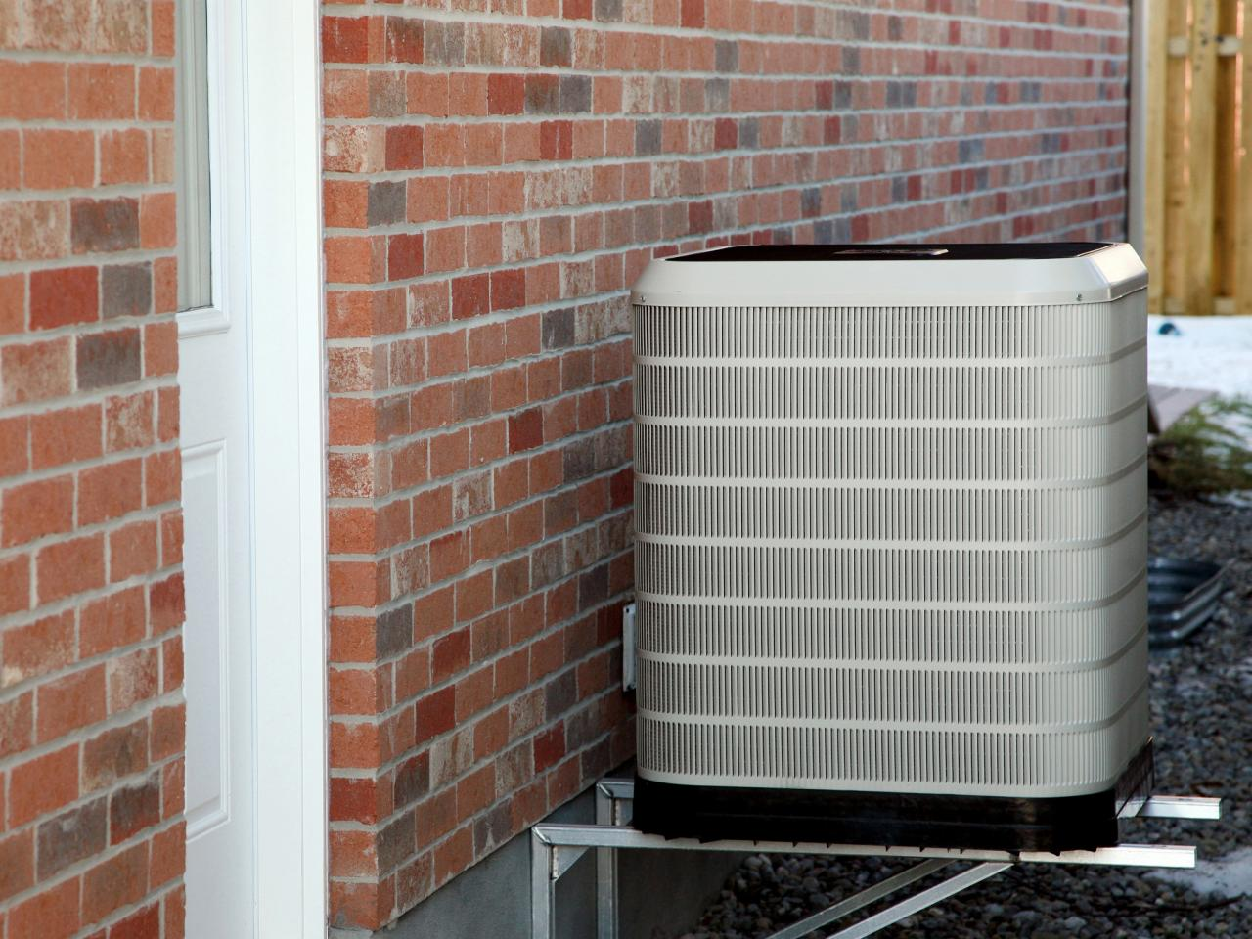
Questions?
Instructions:
Add your logo to bottom left of this slide.
Thank you!
Notes:
Photo: https://www.hgtv.com/design/remodel/mechanical-systems/heat-pump-options-and-uses

